Slide 1

FaceNet: Unified Embedding for Face Recognition and Clustering
Zoalghinah Mohammad FadI
Data Science
University POLITEHNICA of Bucharest
January 21st, 2025
Notes:
FaceNet was introduced in 2015 by researchers from Google in the paper titled "FaceNet: A Unified Embedding for Face Recognition and Clustering". The system revolutionized face recognition by utilizing a deep convolutional neural network trained with Triplet Loss to produce highly discriminative embeddings for tasks like face verification, recognition, and clustering.

Slide 2
Introduction!
Objective: Unified system for face verification, recognition, and clustering.
Approach: It maps faces into a compact, 128-dimensional Euclidean space where distances directly correspond to face similarity.
Key Tasks: Simplifies recognition and clustering using compact embeddings.
Interactive Use Case: "Imagine grouping your family photos automatically based on who is in them. That’s what FaceNet does!"
Verification - is this the same person?
Recognition - who is this person?
Clustering - find common people among these faces
Notes:
FaceNet is a deep learning system designed for face verification, recognition, and clustering. It maps face images into a compact 128-dimensional embedding space, where the Euclidean distance directly represents face similarity.
Unlike earlier methods, FaceNet is highly efficient, eliminates the need for intermediate steps like PCA or SVM, and achieves state-of-the-art accuracy, making it ideal for large-scale, real-world applications.
The loss function here encourages the projection of similar faces to cluster together in the embedding space.
These loss functions are widely used in face recognition systems to create discriminative embeddings for clustering similar identities while separating different ones.
FaceNet was introduced in 2015 by researchers from Google

Slide 3
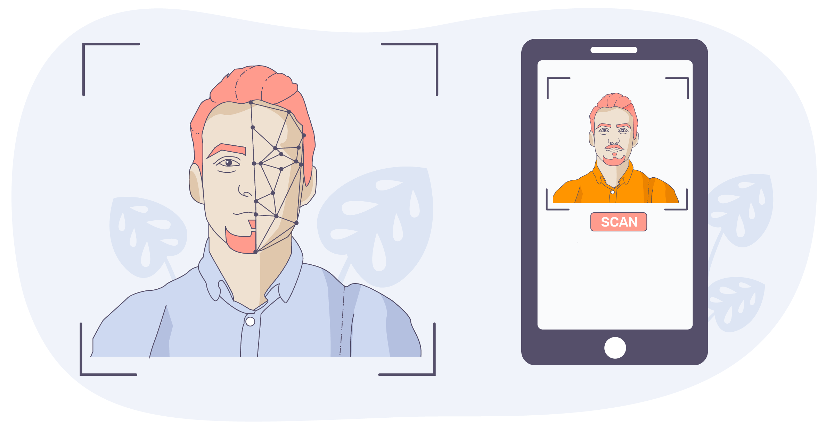
Key Features
Direct Embedding:
Maps images directly to a 128-byte representation without intermediate steps.
Triplet Loss Optimization:
Focuses on separating similar and dissimilar faces with a margin.
Performance:
Labeled Faces in the Wild (LFW): 99.63% accuracy.
YouTube Faces DB: 95.12% accuracy.
Demonstrated a 30% reduction in error compared to prior best results on both datasets.
Notes:
FaceNet achieved 99.63% accuracy on LFW (Labeled Faces in the Wild), surpassing many earlier methods like DeepFace and DeepID.
What is LFW (Labeled Faces in the Wild)?
Labeled Faces in the Wild (LFW) is a publicly available benchmark dataset widely used in the field of face recognition research. It serves as a standard for evaluating and comparing the performance of face recognition models.
Key Features of LFW
Dataset Size:
Contains 13,233 images of faces.
Images represent 5,749 individuals, with some individuals having multiple photos.
Variability:
Includes faces with diverse variations such as:
Lighting conditions.
Facial expressions.
Backgrounds.
Ages and ethnicities.
Faces are collected from the internet and are largely unconstrained (e.g., different poses, lighting).
Purpose:
Designed to test face verification systems, answering the question: Are these two faces of the same person?
Standard Protocol:
The dataset uses 6,000 face pairs:
3,000 matching pairs (same identity).
3,000 non-matching pairs (different identities).
Models are evaluated based on their accuracy in predicting whether pairs match or not.
Why is LFW Important for FaceNet?
Benchmark for Accuracy:
FaceNet achieved 99.63% accuracy on LFW, surpassing many earlier methods like DeepFace and DeepID.
Real-World Variability:
The dataset’s diversity ensures that models like FaceNet perform well under real-world conditions, such as variations in pose and lighting.
Simplified Comparison:
Provides a standardized protocol, making it easier to compare FaceNet’s performance to other models.
Interactive Example for LFW
Imagine you have two photos:
A passport photo.
A candid photo from a party.
LFW tests whether FaceNet can correctly determine if both photos represent the same person despite differences in lighting, pose, or background.

Slide 4
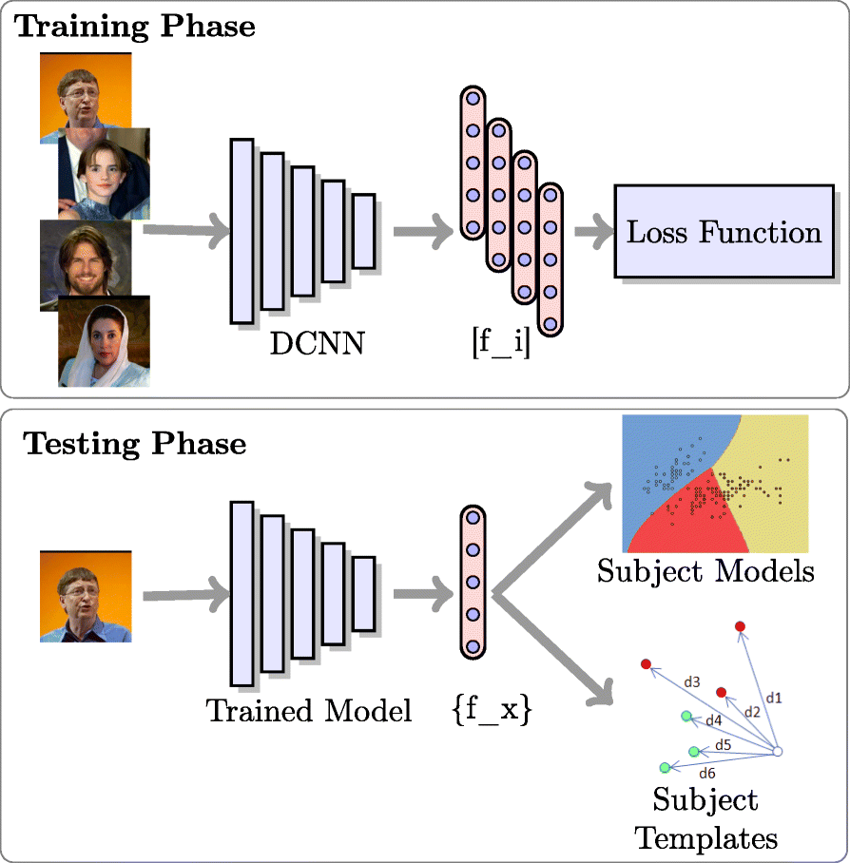
Architectures
Two CNN architectures:
Zeiler & Fergus-based Model
Depth: 22 layers.
Parameters: 140M
FLOPS: 1.6B
High accuracy but computationally expensive.
Inception-based Model (e.g., GoogLeNet)
Depth: Multiple inception modules (up to 28 layers in variants).
Parameters: 7.5M
FLOPS: 500M-1.6B
Compact and efficient, suitable for mobile and resource-limited applications.
Notes:
FaceNet’s architecture is designed to map input face images directly into a 128-dimensional embedding space where distances reflect face similarity. It is based on deep convolutional neural networks (CNNs) and optimized for tasks like face recognition, verification, and clustering.
The loss function here encourages the projection of similar faces to cluster together in the embedding space.
Utilization:
Verification: Thresholding the Euclidean distance between embeddings to verify if two faces belong to the same person.
Recognition: Using a k-nearest neighbor (k-NN) classifier in embedding space.
Clustering: Applying clustering techniques like k-means or agglomerative clustering to group similar faces.
Evaluated two CNN architectures:
*******************
A model based on Zeiler & Fergus with 140 million parameters.
A lightweight Inception-style model with significantly fewer parameters and computational cost, suitable for mobile applications.
Both architectures achieved comparable high performance.
*******************
What Are Parameters?
Parameters: The weights and biases in the neural network that are learned during training.
Weights: Define the connections between neurons.
Biases: Adjust the output of neurons.
Impact: The number of parameters determines the model size and how much memory the model consumes.
Models with more parameters can capture more complex patterns but may require more computational resources and are prone to overfitting.
2. What Are FLOPS?
FLOPS (Floating Point Operations Per Second): Measure the computational complexity of the model.
Refers to the total number of floating-point operations (additions, multiplications, etc.) required to process a single input.
Impact:
Determines the speed of inference.
High FLOPS = More computation per input, meaning higher resource demand.

Slide 5
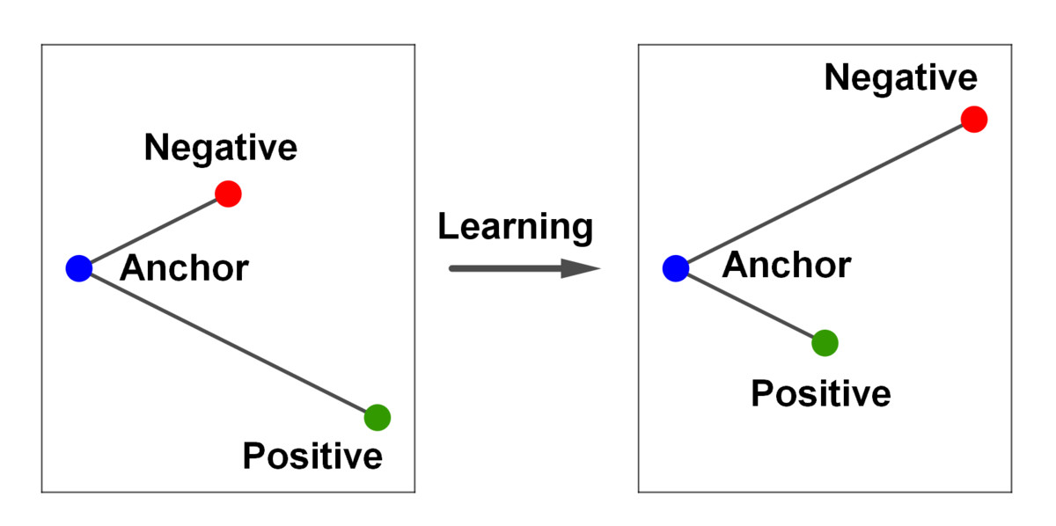
Triplet Loss
Purpose: Ensures embeddings of the same identity are closer, while different identities are farther apart.
Optimization:
Employs hard-negative mining to improve convergence.
Balances anchor-positive and anchor-negative distances with a margin ().
Anchor-Positive-Negative Triplet:
Anchor: Reference face.
Positive: Same person, different conditions (e.g., lighting).
Negative: Different person.
Notes:
Triplet Loss
Triplet Loss is the core of the FaceNet model and works by minimizing the distance between embeddings of the same identity and maximizing the distance between embeddings of different identities.
The loss function here encourages the projection of similar faces to cluster together in the embedding space.
Triplet components:
Anchor: The reference image.
Positive: An image of the same person.
Negative: An image of a different person.
Training the Network
FaceNet uses triplet loss to optimize embeddings:
Input:
A triplet of images: Anchor, Positive (same identity), and Negative (different identity).
Optimization:
Minimizes the distance between Anchor and Positive embeddings.
Maximizes the distance between Anchor and Negative embeddings by at least a margin.
------------------
Hard-Negative Mining
Here, hard-negative mining refers to a strategy used during training to select challenging samples (negatives) that improve the model's ability to distinguish between similar-looking faces.
-----------------
Triplet loss, and why was it chosen?
Definition: Triplet loss is a loss function that ensures embeddings of the same identity are closer in Euclidean space than embeddings of different identities by a predefined margin (α\alphaα).
How it works:
Triplet components:
Anchor: The reference image.
Positive: An image of the same person.
Negative: An image of a different person.
The loss minimizes the distance between the anchor and the positive while maximizing the distance to the negative.
Formula: L=∑i[∥f(xai)−f(xpi)∥2−∥f(xai)−f(xni)∥2+α]+L = \sum_i \big[\|f(x_a^i) - f(x_p^i)\|^2 - \|f(x_a^i) - f(x_n^i)\|^2 + \alpha\big]_+L=i∑​[∥f(xai​)−f(xpi​)∥2−∥f(xai​)−f(xni​)∥2+α]+​ where [⋅]+[\cdot]_+[⋅]+​ indicates the hinge function.
Reason for Choosing Triplet Loss:
Direct Optimization: Unlike classification-based approaches, triplet loss directly optimizes for embedding separation, improving efficiency.
Manifold Preservation: Allows face embeddings of the same identity to occupy a "manifold" rather than collapsing into a single point, improving generalizability.

Slide 6
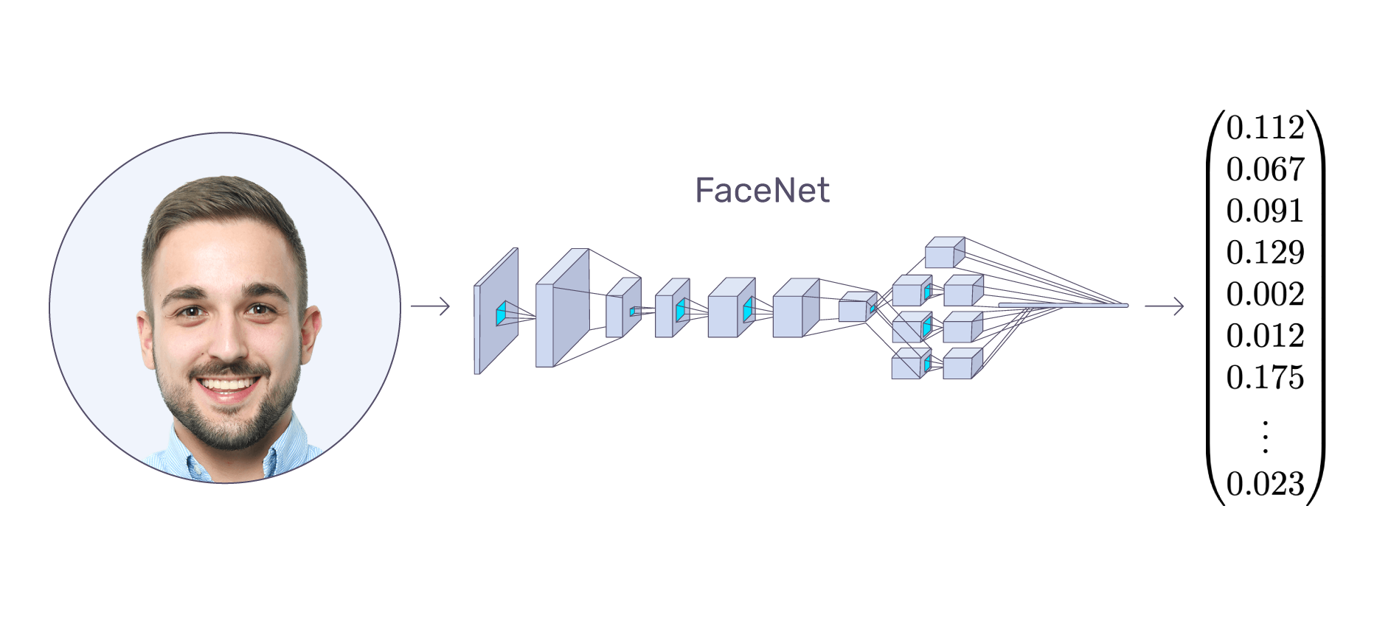
How Does FaceNet Work?
Step-by-Step Process:
Input: A face image.
Embedding Generation: Converts the face into a 128-dimensional vector (a point in space).
Comparison: Measures the Euclidean distance between points to check similarity:
Close points = same person.
Far points = different people.
Clustering: Groups similar faces together automatically.
Example:
Anchor: Your face in one image.
Positive: Your face in another image (similar).
Negative: Your friend’s face (different).
Goal: Keep Anchor and Positive close, push Negative farther away.
Notes:
FaceNet works by mapping facial images into a 128-dimensional embedding space using a deep neural network trained with Triplet Loss. This loss function ensures that embeddings of the same person are close together while embeddings of different people are far apart, enabling tasks like face verification and recognition based on similarity thresholds.

Slide 7
Comparison with Alternatives
Feature | FaceNet | Alternatives (e.g., DeepFace, DeepID)
Embedding Size | 128 bytes | Large (1000+ dimensions)
Training Approach | Direct Triplet Loss | Multi-stage (e.g., PCA, SVM)
Preprocessing | Minimal (tight cropping) | Complex (3D alignment)
Accuracy | 99.63% (LFW) | 97.35%-99.47%
Efficiency | High (compact and fast) | Lower (resource-intensive)
Recognition Approach | Distance-based thresholding | Fixed classification (closed set)
Flexibility | Handles new identities dynamically | Requires retraining for new identities
Notes:
LFW (Labeled Faces in the Wild)
FaceNet differs from earlier models like DeepFace and DeepID, which rely on additional post-processing steps like PCA (Principal Component Analysis) for Dimensionality reduction and SVM (Support Vector Machines) for Classification.

Slide 8
Summary of Key Differences:
Tool | Strengths | Weaknesses
FaceNet | High accuracy, compact embeddings, versatile tasks. | Requires GPU for optimal training.
ArcFace | Angular distance improves performance on difficult tasks. | Slightly complex training setup.
DeepFace | Early pioneer, reliable. | Less efficient than newer models.
Dlib | Lightweight, open-source. | Struggles with large datasets.
Microsoft API | High-quality service, scalable. | Paid subscription required.
Amazon Rekognition | Scalable, cloud-based. | Privacy and cost concerns.
OpenFace | Open-source, academic-friendly. | Slightly outdated compared to FaceNet.
Notes:
The other alternatives are more complex, less efficient, unsuitable for large datasets, or not cost-effective.
The best alternative is: ArcFace
ArcFace Loss builds on the concept of angular distance, which is more robust than Euclidean distance for distinguishing identities. But it is slightly more complex than FaceNet, and both are support the open set face recognition.
Additive Angular Margin Loss

Slide 9
Pros and Cons of FaceNet
Pros: (Why to choose it)
Cons: (Challenges and Limitations)
State-of-the-Art Accuracy: High performance on standard datasets.
Compact Embeddings: Only 128 bytes per face, enabling scalability.
Simplified Workflow: End-to-end learning eliminates intermediate steps.
Versatility: Works for verification, recognition, and clustering.
Open Set Recognition
High Training Requirements: Needs large datasets and computational resources.
Complex Triplet Selection: Requires careful mining of hard negatives for training.
Deployment Constraints: Optimization needed for mobile devices.
Notes:
open set recognition refers to the ability of a system to handle cases where some faces have not been seen during training. This contrasts with closed set recognition, where the system is limited to recognizing faces from a predefined set of identities (the training set).
I consider open-set recognition to be the greatest advantage of FaceNet, as I am integrating it with YOLO, FastReID, and ByteTrack to create a system for locating a lost individual.
Hard-Negative Mining
Here, hard-negative mining refers to a strategy used during training to select challenging samples (negatives) that improve the model's ability to distinguish between similar-looking faces.
What is Open Set Recognition in FaceNet?
Here, open set recognition refers to the ability of a system to handle cases where some faces have not been seen during training. This contrasts with closed set recognition, where the system is limited to recognizing faces from a predefined set of identities (the training set).
How Does FaceNet Handle Open Set Recognition?
FaceNet is inherently well-suited for open set recognition due to its design:
Embedding in Euclidean Space:
Each face is represented as a 128-dimensional vector in a continuous Euclidean space.
Unlike traditional classification models, it does not rely on a fixed set of known classes.
Similarity-Based Comparison:
Recognition is performed by comparing the distance between embeddings rather than classifying them into fixed categories.
For new faces, the system can evaluate whether the distance is below a threshold to determine if it matches a known identity.
Thresholding for Unknown Faces:
A configurable threshold can be set to decide if a face belongs to a known individual or is entirely new.
For example:
Distance < Threshold → Known identity.
Distance ≥ Threshold → Unknown identity.
Why is Open Set Recognition Powerful?
Flexibility:
The system can dynamically handle new identities without retraining.
For example, adding a new employee to a workplace recognition system is as simple as storing their embedding.
Scalability:
The 128-byte embeddings allow efficient storage and retrieval for millions of identities.
Real-World Applicability:
Works in scenarios where new people are frequently encountered, such as:
Surveillance systems.
Photo organization apps.
Access control systems.
What Is Hard Negative Mining?
Mining refers to selecting the most challenging negative samples for training.
Strategies include:
Online Mining:
Select hard negatives on-the-fly during training, from the current mini-batch.
Example: Use the negatives with the smallest distance to the anchor but still greater than the positive.
Offline Mining:
Precompute hard negatives from the dataset before training.

Slide 10
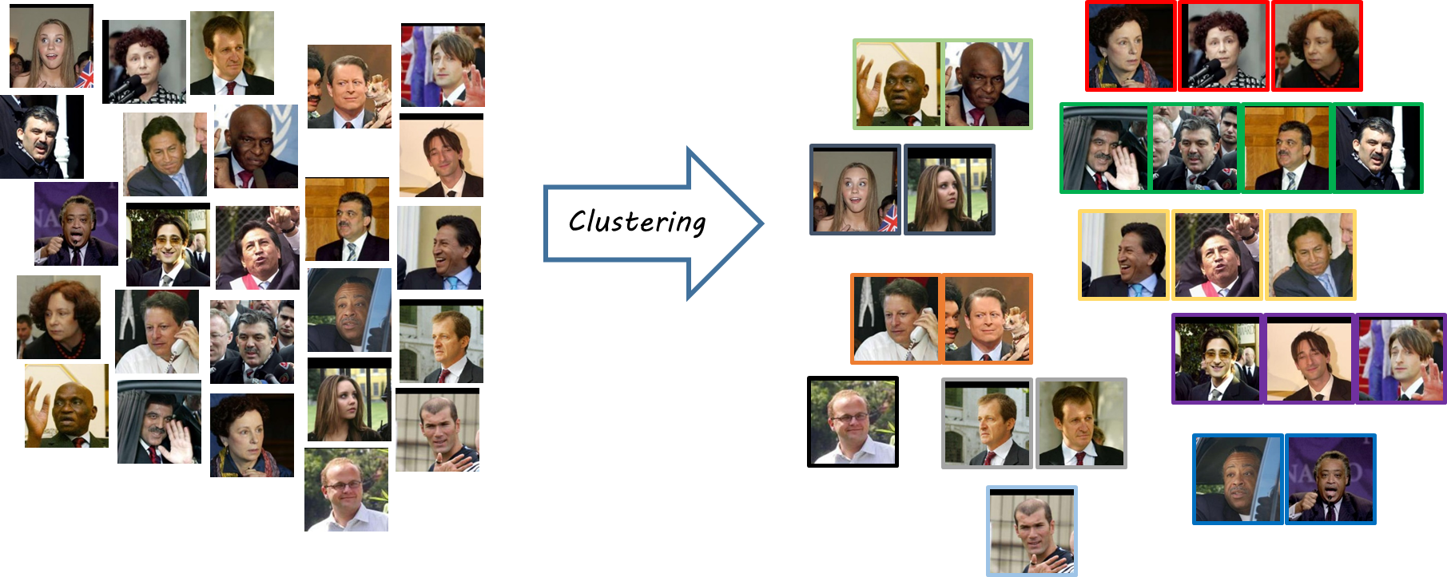
Applications
Face Verification: Threshold Euclidean distances between embeddings.
Face Recognition: Apply k-NN classification in embedding space.
Face Clustering: Use k-means or agglomerative clustering to group faces.
Security: Face authentication systems (e.g., unlocking devices).
Photo Organization: Grouping similar faces in personal photo libraries.
Surveillance: Identifying individuals in public spaces.
Social Media: Tagging people automatically in photos.

Slide 11
Cross-Functionality
1. Face Verification
2. Face Recognition
3. Clustering
4. Open-Set Recognition
Scalability
Key Strengths of Cross-Functionality
Embedding-Based Representation
Task-Agnostic Nature
Efficiency
Notes:
The cross-functionality of FaceNet refers to its ability to handle multiple face-related tasks using a single embedding-based framework. Its design is not limited to one specific application but instead provides a versatile system capable of addressing various face recognition and verification needs. Here’s how FaceNet demonstrates its cross-functionality:
1. Face Verification
Task: Verifying whether two facial images belong to the same person.
How it Works: FaceNet generates 128-dimensional embeddings for both faces and computes the Euclidean distance between them. If the distance is below a threshold, the faces are considered to belong to the same individual.
Application: Login authentication systems, access control, and identity verification.
2. Face Recognition
Task: Identifying a person from a database of known faces.
How it Works: FaceNet generates embeddings for an input face and compares them to embeddings stored in a reference database. The closest match based on similarity measures (e.g., Euclidean distance) determines the identity.
Application: Surveillance systems, social media tagging, and photo organization.
3. Clustering
Task: Grouping similar faces together into clusters.
How it Works: Using the embedding space, FaceNet organizes faces based on proximity, where similar faces (same identity) are closer together, and different identities are farther apart.
Application: Photo album grouping, large-scale facial dataset management, and social media recommendations.
4. Open-Set Recognition
Task: Determining if a face belongs to a known identity or is entirely new.
How it Works: FaceNet checks the distance between the input embedding and the closest embeddings in the database. If the distance exceeds a defined threshold, the face is classified as unknown.
Application: Security and surveillance, fraud detection, and real-time monitoring.
5. Scalability
Task: Supporting large-scale datasets and real-time processing.
How it Works: FaceNet’s compact embeddings (128 dimensions) allow for efficient storage, fast comparisons, and scalability to handle millions of faces.
Application: Enterprise-level systems like large-scale biometric authentication or global surveillance networks.
Key Strengths of Cross-Functionality
Embedding-Based Representation: FaceNet focuses on creating universal embeddings that can be used for diverse tasks without retraining the network for each application.
Task-Agnostic Nature: The same embeddings can support tasks like clustering, recognition, and verification.
Efficiency: Embedding comparison (using Euclidean or cosine distance) is computationally lightweight, making it suitable for both real-time and large-scale applications.
Summary
FaceNet’s cross-functionality lies in its ability to generate embeddings that serve as a foundation for multiple face-related tasks. Whether for recognition, verification, or clustering, its versatile design makes it adaptable to various domains while maintaining high accuracy and efficiency. This versatility has made it a benchmark in the field of face recognition.

Slide 12
Conclusion
FaceNet simplifies face recognition tasks while achieving exceptional accuracy and efficiency.
Its versatility, scalability, and compact design make it a game-changer for many industries.
Let’s imagine a future where recognizing faces is as easy as reading a map — that’s the power of FaceNet.
Notes:
FaceNet’s architecture is a powerful combination of deep CNNs and efficient loss functions (triplet loss). By leveraging scalable designs like Inception modules, it balances accuracy, efficiency, and compactness, making it a standout solution for face-related tasks in real-world applications.

Slide 13

Q&A

